Slide 2
116th ANNUAL GENERAL MEETING
02 November 2023

Slide 3
AGENDA
Welcome and introductions
To approve the minutes of the 115th AGM, held on 24 November 2022
The Chairman’s Report
The General Manager’s Report
Finance Report and Audited Accounts for the year ended 30 April 2023
To reappoint Alliotts as auditors
To re-elect the President
To re-elect the Chairman
To re-elect the Treasurer
To elect four Members of Council
Club and winter season discussion

Slide 4
INTRODUCTIONS
Angus Maciver​
Walter Macharg
James Gambrill​
Owen Barks Chapman​
Katy Ellis
Stephen Meredith (independent auditor)​ ​
... and meeting logistics

Slide 5
MEETING LOGISTICS
We will mute everyone during presentation periods
Feel free to use the chat function throughout the session
The AGM will be recorded
We aim to have more open discussions between sections and at the end, depending on timing

Slide 6
AGENDA
Welcome and introductions
To approve the minutes of the 115th AGM, held on 24 November 2022
The Chairman’s Report
The General Manager’s Report
Finance Report and Audited Accounts for the year ended 30 April 2023
To reappoint Alliotts as auditors
To re-elect the President
To re-elect the Chairman
To re-elect the Treasurer
To elect four Members of Council
Club and winter season discussion
Approve Minutes | Votes
For | 46
Against | 0
Abstain | 3
Chair’s discretion | 0
Total | 49

Slide 7
AGENDA
Welcome and introductions
To approve the minutes of the 115th AGM, held on 24 November 2022
The Chairman’s Report
The General Manager’s Report
Finance Report and Audited Accounts for the year ended 30 April 2023
To reappoint Alliotts as auditors
To re-elect the President
To re-elect the Chairman
To re-elect the Treasurer
To elect four Members of Council
Club and winter season discussion

Slide 8
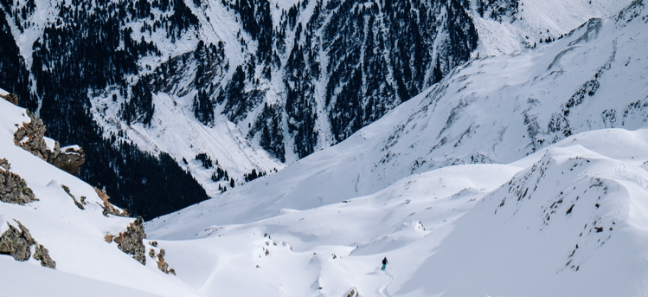
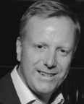
CHAIRMANS REPORT 2023
02 November 2023

Slide 9
22/23 RESULTS OVERVIEW
Decent Year
Reasonable Surplus
Good team - retained
Strong Cash flow
Good level of New Members
Negatively balanced by too many existing members leaving
Expansion of Reps
More Holidays
More Platinum members
Balance Sheet stable

Slide 10
22/23 TEAM OVERVIEW
Stability of key members
90% retention
Key senior team experienced – Katy Ellis (Holidays) , Jitendra Shetty Finance) and Owen Chapman (Membership/On Snow)
Newer members of the team have been retained

Slide 11
22/23 GOVERNANCE OVERVIEW
Continuation of approach
Positive Transition
Retaining Advisory Groups and mix of elected and co-opted members
Sought out HR, Holidays and Reps for expertise
2 existing co-opted members and 2 new elected members up for election,
2 new Co-opted (Reps and Holidays)
New Heritage Advisory Group set up led by Peter Slee and Nic Oatridge - off to a great start!
Thanks to Martin Jordan and Anthony (Tony) Harris – both of whom will still be on groups

Slide 12
MEMBER SERVICES
Expanding carefully
Reps – numbers and appreciation
Holidays – expanded and quality improved
Partnerships – more/better

Slide 13
OUTLOOK
Improved services and focus on membership
New IT system
More Reps
Built in Private Liability Insurance
New membership card
More Holidays
More Marketing and more needed
Always with an eye on making a surplus.

Slide 14
REFLECTIONS ON THE MAJOR CHALLENGES
Challenges/Questions:
How do we grow awareness and membership?
How do we then move into different demographics?
How do we best use the Club’s reserves?
Where does Mountain Tracks fit in our structure?

Slide 15
MID TERM CHALLENGE
To secure and grow membership whilst lowering the average age over the next three years by enhancing member benefits whilst maintaining financial and operational stability.
We will do that by focussing on the following areas:
Grow membership by 5% whilst reducing average age of membership by one year each year.
Ensure club is stable both financially and operationally.
Increase quality (and enhance the experience) of club services.

Slide 16
AGENDA
Welcome and introductions
To approve the minutes of the 115th AGM, held on 24 November 2022
The Chairman’s Report
The General Manager’s Report
Finance Report and Audited Accounts for the year ended 30 April 2023
To reappoint Alliotts as auditors
To re-elect the President
To re-elect the Chairman
To re-elect the Treasurer
To elect four Members of Council
Club and winter season discussion

Slide 17
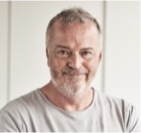
GENERAL MANAGERS REPORT 2023
02 November 2023

Slide 18
STABILITY
Financial
Operational
Attrition

Slide 19
CHOICES
Ideas
Opportunities
Resources

Slide 20
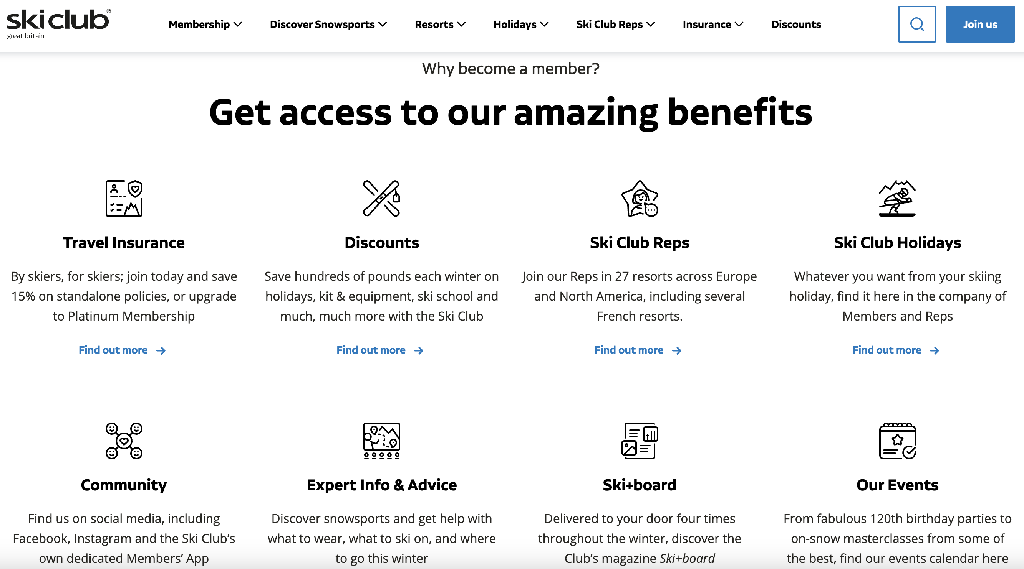
WHY DO PEOPLE JOIN?

Slide 21
PARTNERSHIPS
Benefits
Awareness
Understanding

Slide 22
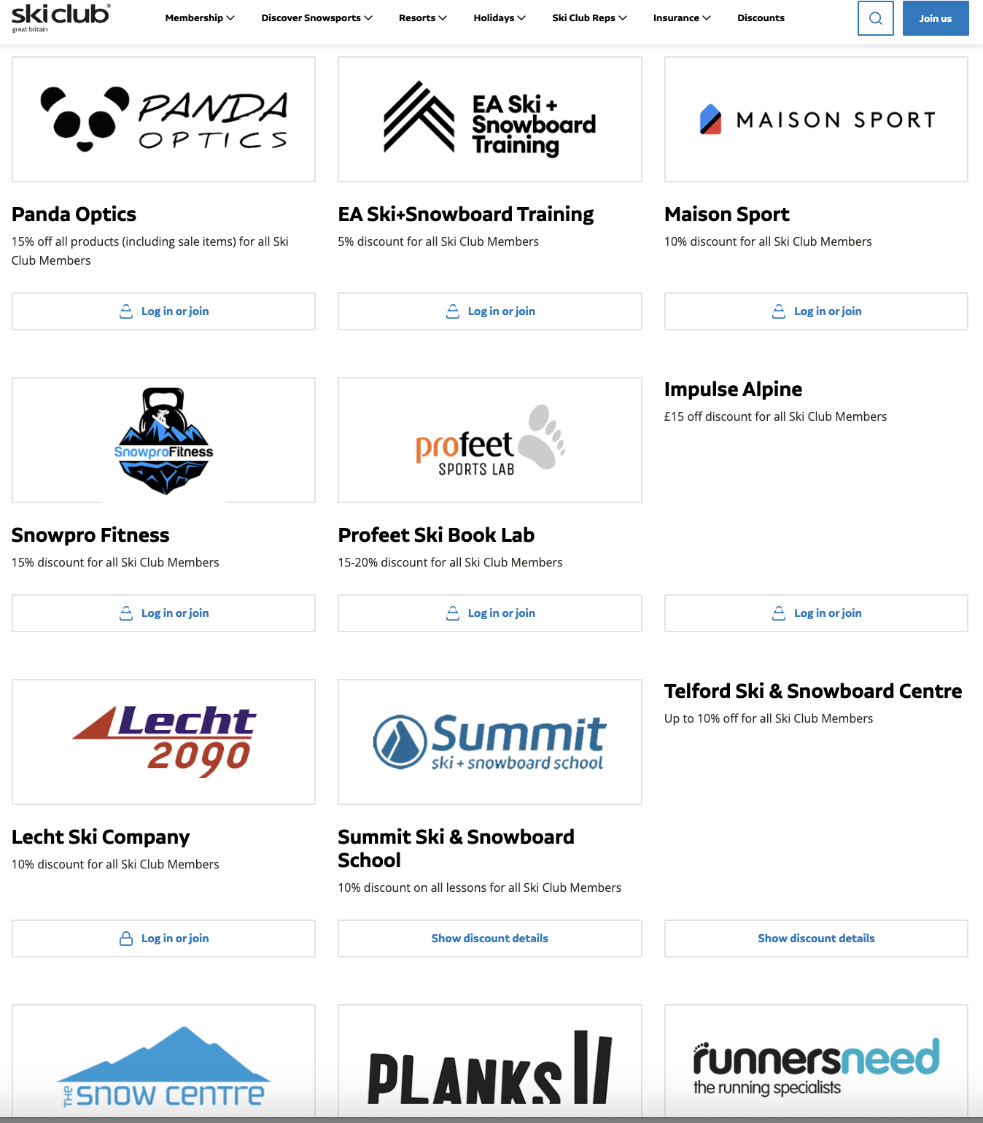
PARTNERSHIPS

Slide 23
IT
Member experience
Information
Membership trends
Behaviour

Slide 24
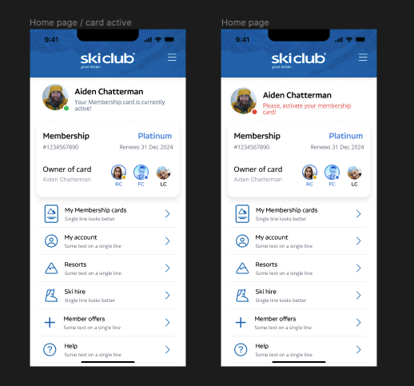
EMBRACING TECHNOLOGY

Slide 25
DISCOVER BETTER SKIING!
Tight focus
Quality of key services improved, and improving.
Better in resort service, better holidays, better insurance, better member benefits, better events

Slide 26
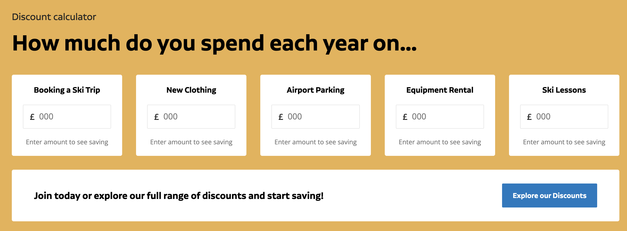
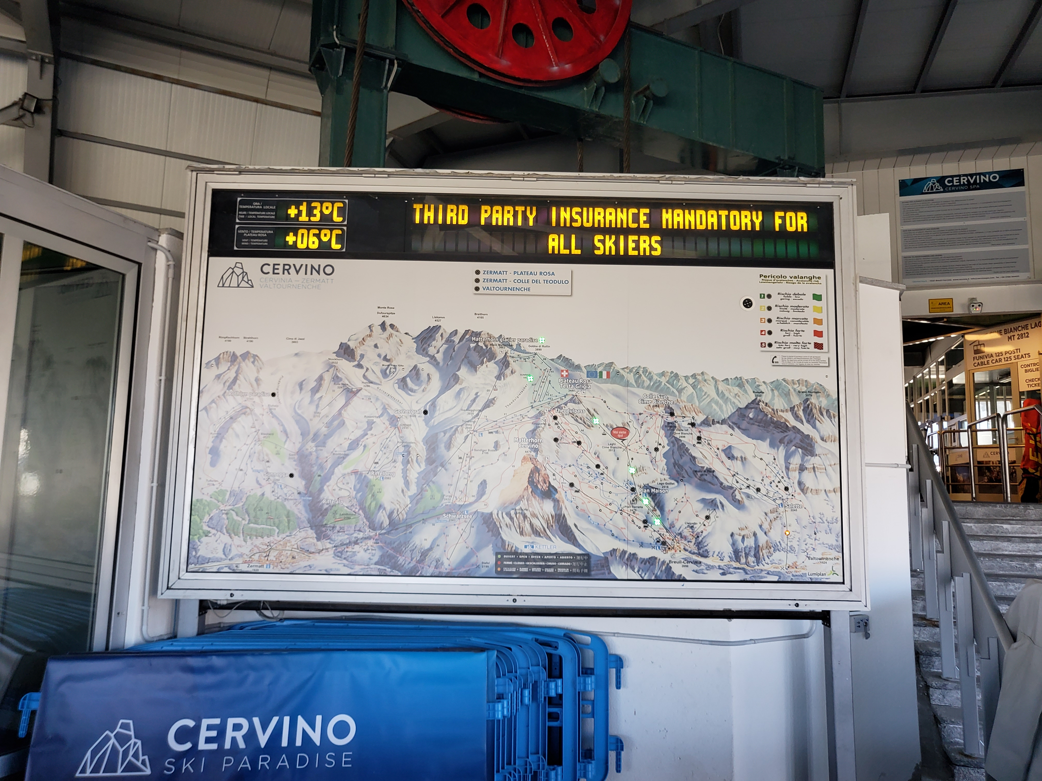
IT’S ALL ABOUT BETTER….

Slide 27
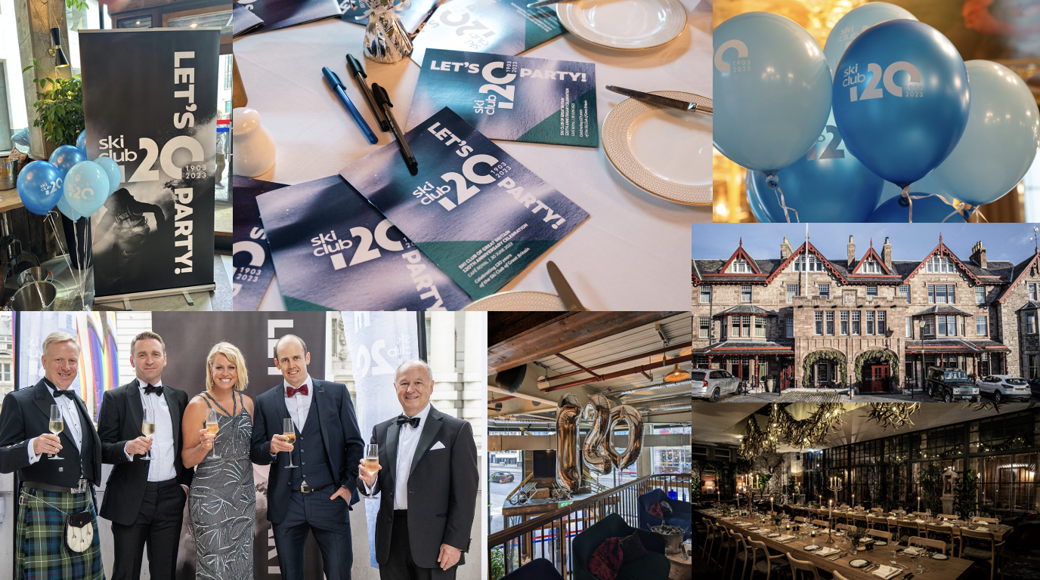
CELEBRATING 120 YEARS OF THE CLUB

Slide 28
THE CLUB IN IT’S 120TH YEAR
Role
Enhancing the ski experience
Reducing the cost

Slide 29
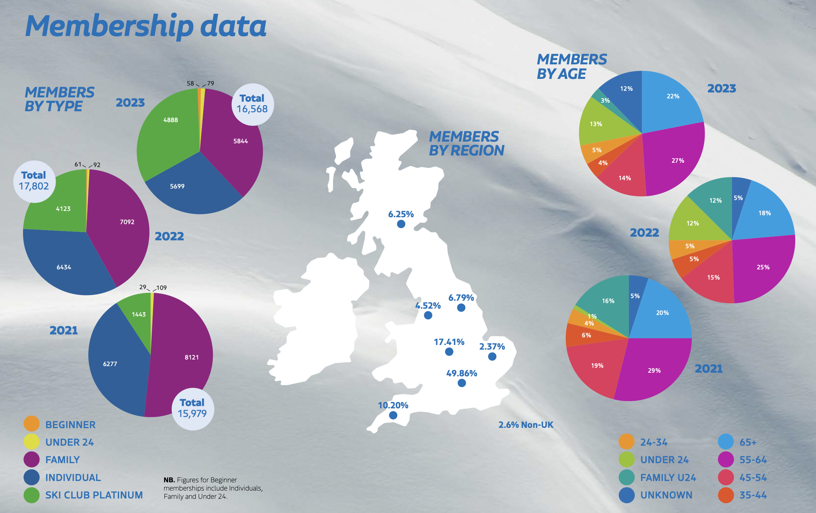
MEMBERSHIP

Slide 30
CHALLENGES
Awareness
9% unprompted
17% prompted
0.1% of UK Skiers (1:1000)
Communication
Engagement

Slide 31
QUESTIONS

Slide 32
AGENDA
Welcome and introductions
To approve the minutes of the 115th AGM, held on 24 November 2022
The Chairman’s Report
The General Manager’s Report
Finance Report and Audited Accounts for the year ended 30 April 2023
To reappoint Alliotts as auditors
To re-elect the President
To re-elect the Chairman
To re-elect the Treasurer
To elect four Members of Council
Club and winter season discussion
Approve Audited Accounts | Votes
For | 47
Against | 0
Abstain | 2
Chair’s discretion | 0
Total | 49

Slide 33
AGENDA
Welcome and introductions
To approve the minutes of the 115th AGM, held on 24 November 2022
The Chairman’s Report
The General Manager’s Report
Finance Report and Audited Accounts for the year ended 30 April 2023
To reappoint Alliotts as auditors
To re-elect the President
To re-elect the Chairman
To re-elect the Treasurer
To elect four Members of Council
Club and winter season discussion

Slide 34
FINANCE REPORT 2022/23
Income:
Membership income increase although total headcount down – more platinum members
Holiday income growth
Partnership and advertising income continues to grow
Costs have increased so operating profit is lower
More rep resorts
Increased communications with members and the wider market
Some strengthening of the staff team

Slide 35
FINANCE REPORT 2022/23
Difficult year for investment markets – 4% net decrease in investment portfolio
Hence a net loss before tax
Cash flow positive, after the investment in the new website and systems
Net assets of £2.88m, 3.5% down on last year
At 30 April we held a loan from our investment managers of £774k inc. accumulated interest. This was paid off after the year end, which will reduce our net interest costs.
Investment policy updated this year, including ESG policy
The financial plan for 23/24 is for continued growth in the Club’s activities with firm cost control – to result in a net surplus similar to this year.

Slide 36
FINANCE REPORT 2022/23
Summary of Consolidated Profit and Loss statement- year to 30 April
 | 2022/23 | 2021/22 | 2020/21 | 2019/20
 | £ | £ | £ | £
Revenue
Membership subscriptions | 1,391,630 | 1,309,421 | 1,214,425 | 1,431,987
Holidays | 3,310,504 | 2,832,177 | 9,356 | 2,927,181
Commission and other partnership income | 244,060 | 181,895 | 37,990 | 345,222
 | 4,946,194 | 4,323,493 | 1,261,771 | 4,704,390
Cost of sales
Direct costs | (3,325,332) | (2,508,362) | (176,146) | (2,951,321)
Direct staff costs | (548,780) | (383,499) | (524,938) | (893,306)
Communications & IT | (496,993) | (315,422) | (141,973) | (425,473)
 | (4,371,106) | (3,207,283) | (843,057) | (4,270,101)
Gross Profit | 575,088 | 1,116,210 | 418,714 | 434,289
Overheads
Staff costs | (179,300) | (253,907) | (260,752) | (365,813)
Premises and administrative | (76,005) | (158,077) | (252,547) | (484,254)
IT and marketing | (171,458) | (119,473) | (167,246) | (364,131)
Insurance, legal and professional, finance | (90,123) | (79,965) | (107,765) | (168,707)
Other operating income | - | 91,383 | 143,065 | 16,171
Amortisation and depreciation | (10,664) | (19,550) | (22,517) | (84,741)
Exceptional items | - | (270,046) | - | (236,654)
 | (527,551) | (809,635) | (667,762) | (1,688,128)
Operating profit / (loss) | 47,538 | 306,575 | (249,048) | (1,253,839)
Net investment income and interest | 10,305 | 14,511 | 22,987 | 64,249
Net investment gain / (loss) | (151,791) | 34,517 | 593,901 | (7,966)
Profit / (loss) before tax | (93,948) | 355,603 | 367,840 | (1,197,556)
Taxation | (11,531) | (34,600) | - | 458
Profit / (loss) for the year | (105,479) | 321,003 | 367,840 | (1,197,098)

Slide 37
FINANCE REPORT 2022/23
Summary of Consolidated Balance Sheet - 30 April
 | 2023 | 2022 | 2021
 | £ | £ | £
Investments | 3,586,345 | 3,702,358 | 3,985,447
Cash | 766,424 | 721,803 | 214,567
Borrowings | (866,773) | (834,756) | (816,866)
Other net liabilities | (601,759) | (599,689) | (714,435)
 | 2,884,237 | 2,989,716 | 2,668,713

Slide 38
QUESTIONS

Slide 39
AGENDA
Welcome and introductions
To approve the minutes of the 115th AGM, held on 24 November 2022
The Chairman’s Report
The General Manager’s Report
Finance Report and Audited Accounts for the year ended 30 April 2023
To reappoint Alliotts as auditors
To re-elect the President
To re-elect the Chairman
To re-elect the Treasurer
To elect four Members of Council
Club and winter season discussion
Re-appoint Alliotts | Votes
For | 43
Against | 0
Abstain | 6
Chair’s discretion | 0
Total | 49

Slide 40
AGENDA
Welcome and introductions
To approve the minutes of the 115th AGM, held on 24 November 2022
The Chairman’s Report
The General Manager’s Report
Finance Report and Audited Accounts for the year ended 30 April 2023
To reappoint Alliotts as auditors
To re-elect the President
To re-elect the Chairman
To re-elect the Treasurer
To elect four Members of Council
Club and winter season discussion
Elect Trevor Campbell Davis | Votes
For | 44
Against | 1
Abstain | 4
Chair’s discretion | 0
Total | 49

Slide 41
AGENDA
Welcome and introductions
To approve the minutes of the 115th AGM, held on 24 November 2022
The Chairman’s Report
The General Manager’s Report
Finance Report and Audited Accounts for the year ended 30 April 2023
To reappoint Alliotts as auditors
To re-elect the President
To re-elect the Chairman
To re-elect the Treasurer
To elect four Members of Council
Club and winter season discussion
Elect Angus Maciver | Votes
For | 45
Against | 0
Abstain | 4
Chair’s discretion | 0
Total | 49

Slide 42
AGENDA
Welcome and introductions
To approve the minutes of the 115th AGM, held on 24 November 2022
The Chairman’s Report
The General Manager’s Report
Finance Report and Audited Accounts for the year ended 30 April 2023
To reappoint Alliotts as auditors
To re-elect the President
To re-elect the Chairman
To re-elect the Treasurer
To elect four Members of Council
Club and winter season discussion
Elect Walter Macharg | Votes
For | 44
Against | 2
Abstain | 3
Chair’s discretion | 0
Total | 49

Slide 43
AGENDA
Welcome and introductions
To approve the minutes of the 115th AGM, held on 24 November 2022
The Chairman’s Report
The General Manager’s Report
Finance Report and Audited Accounts for the year ended 30 April 2023
To reappoint Alliotts as auditors
To re-elect the President
To re-elect the Chairman
To re-elect the Treasurer
To elect four Members of Council
Club and winter season discussion
Elect Jean Lovett | Votes
For | 42
Against | 0
Abstain | 7
Chair’s discretion | 0
Total | 49

Slide 44
AGENDA
Welcome and introductions
To approve the minutes of the 115th AGM, held on 24 November 2022
The Chairman’s Report
The General Manager’s Report
Finance Report and Audited Accounts for the year ended 30 April 2023
To reappoint Alliotts as auditors
To re-elect the President
To re-elect the Chairman
To re-elect the Treasurer
To elect four Members of Council
Club and winter season discussion
Elect Evelyn Mckinnie | Votes
For | 41
Against | 1
Abstain | 7
Chair’s discretion | 0
Total | 49

Slide 45
AGENDA
Welcome and introductions
To approve the minutes of the 115th AGM, held on 24 November 2022
The Chairman’s Report
The General Manager’s Report
Finance Report and Audited Accounts for the year ended 30 April 2023
To reappoint Alliotts as auditors
To re-elect the President
To re-elect the Chairman
To re-elect the Treasurer
To elect four Members of Council
Club and winter season discussion
Elect Cris Baldwin-Cristoffison | Votes
For | 38
Against | 4
Abstain | 7
Chair’s discretion | 0
Total | 49

Slide 46
AGENDA
Welcome and introductions
To approve the minutes of the 115th AGM, held on 24 November 2022
The Chairman’s Report
The General Manager’s Report
Finance Report and Audited Accounts for the year ended 30 April 2023
To reappoint Alliotts as auditors
To re-elect the President
To re-elect the Chairman
To re-elect the Treasurer
To elect four Members of Council
Club and winter season discussion
Elect Kenneth MacAllister | Votes
For | 41
Against | 3
Abstain | 5
Chair’s discretion | 0
Total | 49

Slide 47
AGENDA
Welcome and introductions
To approve the minutes of the 115th AGM, held on 24 November 2022
The Chairman’s Report
The General Manager’s Report
Finance Report and Audited Accounts for the year ended 30 April 2023
To reappoint Alliotts as auditors
To re-elect the President
To re-elect the Chairman
To re-elect the Treasurer
To elect four Members of Council
Club and winter season discussion

Slide 48
QUESTIONS & DISCUSSION
Just a general question on what initial plans you have to increase the number of resorts that the ski club will be adding in the next season 2024/25.
Are there any plans to revive the reps' ski test event in the future? I was booked on such a session in Pila in March 2020 but this was cancelled (due to COVID I think) and I haven't seen a similar event since. Thanks
On the new website will it be possible to upload photos from Club holidays (as was possible a few years ago)? Or is the app the right place now?
Just wondering about the reported prevalence of Covid 19 in the European Ski Areas at present. Has it ticked up a little as in UK or is it worse/better than here? Also are there any particular Covid restrictions using ski lifts/gondolas still in place this season please?
I am sure everyone is delighted that there are more rep resorts. What plans are there to manage the relationship with a growing number of resorts in the future and how will this differ from the recent past.
Some time in the future it might be useful on the resort site to list the lift system ie 1 cable car, 3 bubbles, 10 chair lifts etc

